Slide 1



Global Sales Analysis & Forecasting ETL Pipeline
Ingesting, Transforming, and Analyzing Multi-Country Sales Data on Google Cloud

Slide 2

Introduction
Design a scalable ETL pipeline to consolidate sales data from 8 countries (varied formats/databases), standardize currency to INR, clean null values, and enable forecasting for production planning.
Key Focus Areas:
Multi-source ingestion (SQL Server, CSV, JSON, Excel, MySQL, etc.).
Currency conversion (HKD, JPY, etc. → INR).
Forecasting future sales using historical trends.

Slide 3
Team Members
Mohammed Abdul Rahman
VEERA SWAMY BADINEEDI
Nikhilesh Reddy
Kuppani Saikiran
Swetha Shree Jaya Sundar
Praveen Kumar S

Slide 4
01
Project Overview

Slide 5
Objective of the Project
Ingest sales data from 8 countries in various formats.
Normalize currencies and unify schema.
Clean, transform, and consolidate data into INR.
Load cleaned data into BigQuery.
Enable forecasting, tax computation, and insightful visualizations.

Slide 6
Tools and Technologies Used
Languages : Python, SQL
Platforms : Google Cloud Platform (GCP), Apache Airflow
Services : Cloud Storage, Composer, Cloud SQL (MySQL/PostgreSQL), AlloyDB, BigQuery.
Visualization : Google Data Studio / Looker Studio

Slide 7
Project Workflow Overview
Sales data from 8 countries is collected in various formats (SQL, CSV, JSON, Excel) and ingested into Google Cloud. The entire ETL process is orchestrated using Cloud Composer (Apache Airflow). Python and SQL scripts are triggered via DAGs to clean the data, handle null values, standardize schema, and convert all prices to INR. The processed data is consolidated and stored in BigQuery, enabling stakeholders to access reports, dashboards, and forecasts for business decision-making.

Slide 8
Data Ingestion
Country | Source Type | Format
India | SQL Serv | Table
Japan | GCP Storage Bucket | CSV
Norway | AlloyDB (PostgreSQL) | Table
Sri Lanka | Separate GCP Bucket | JSON
Hong Kong | GCP Storage Bucket | Excel
Oman | MySQL (Cloud SQL) | Table
Germany | MySQL (Cloud SQL) | Table
Qatar | MySQL (Cloud SQL) | Table

Slide 9
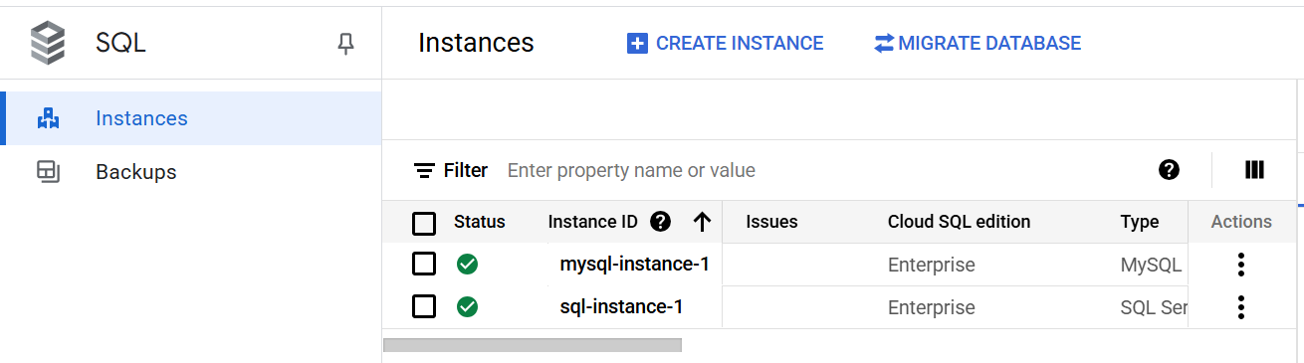
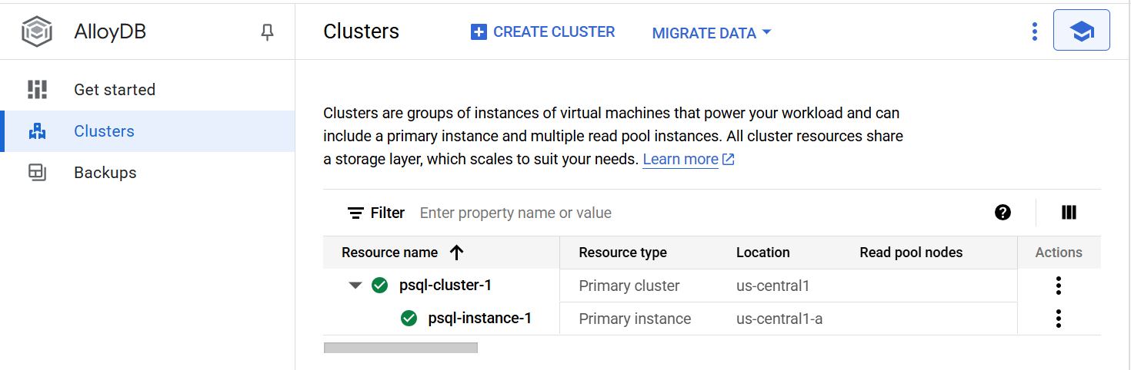
Instances

Slide 10
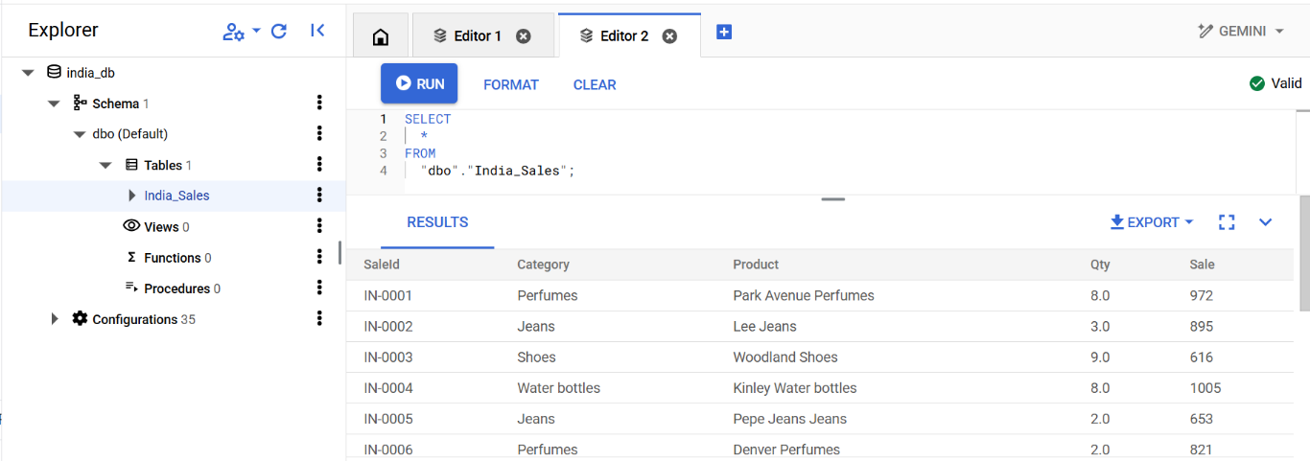
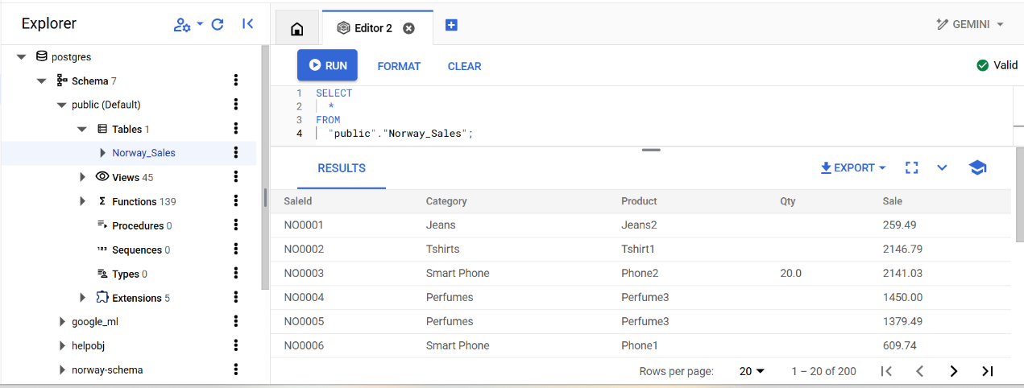
Databases and Tables

Slide 11
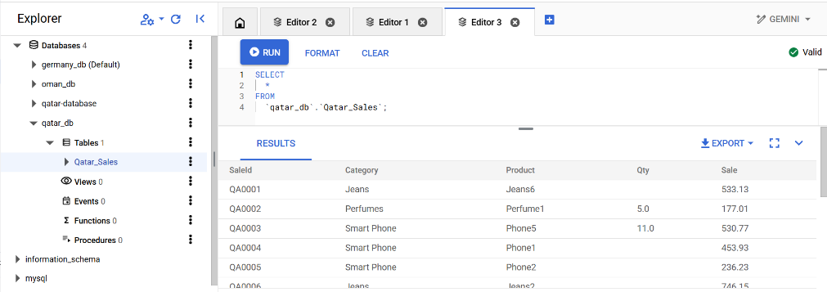
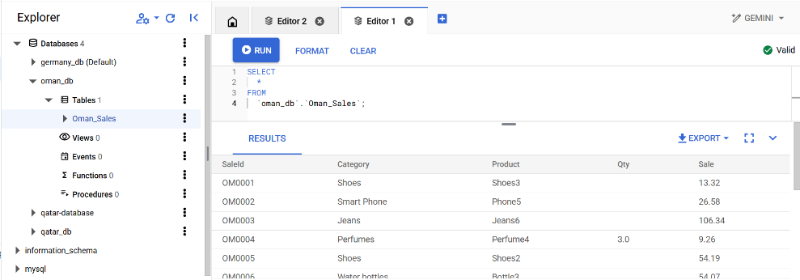
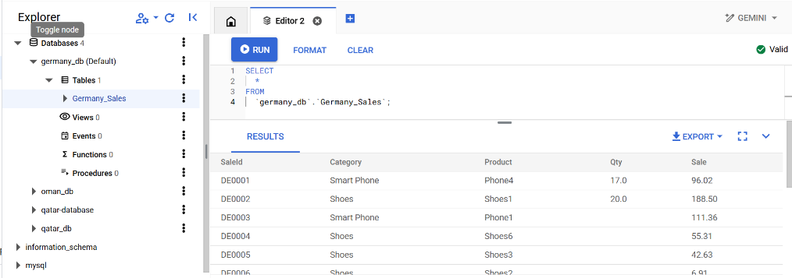
Databases and Tables

Slide 12
Data Cleaning and Transformation
Removed null values.
Converted currencies to INR using static exchange rates (e.g., 1 HKD = 10.93 INR).
Price range normalized between ₹500 and ₹1200.

Slide 13
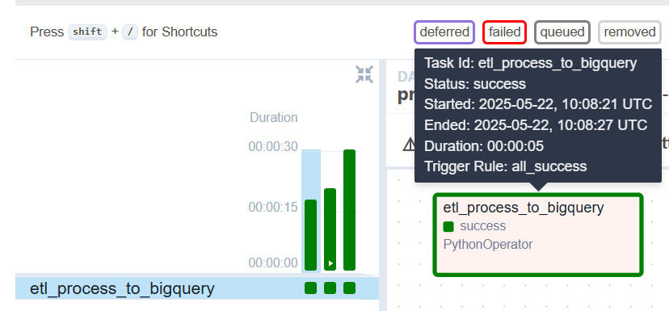
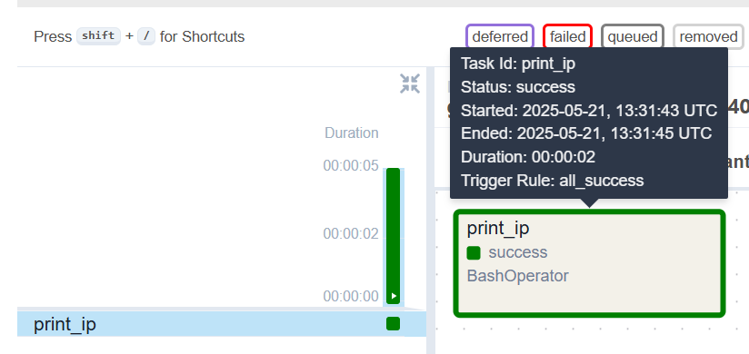
Output Status

Slide 14
Data Storage & BigQuery Integration
Cleaned data written to Cloud SQL or BigQuery.
Used BigQuery connectors and SQL scripts for:
Generating aggregate tables
Creating tax tables with 5% tax
Creating pivot tables for visual dashboards

Slide 15
Analysis and Visualization
A. CSV Export for Stakeholders
B. Graphs for Business Teams
C. Tax Department Reports
D. Additional Charts

Slide 16
Conclusions
This ETL project empowers the organization to make data-driven decisions by centralizing global sales data, standardizing metrics, and providing intuitive dashboards for strategic planning, forecasting, and compliance.

Slide 17
Thank you!

